Slide 1
CS2033a/b Multimedia and Communications II Lecture 11 E-Commerce
Vivi Tryphonopoulos

Slide 2
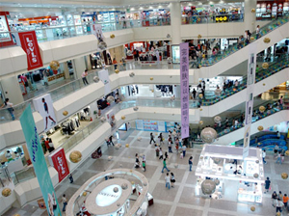
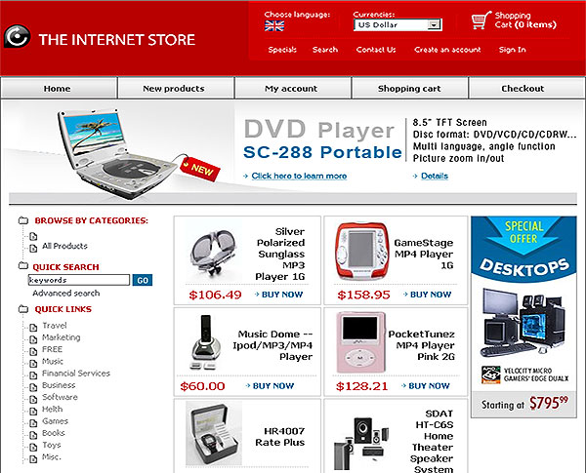
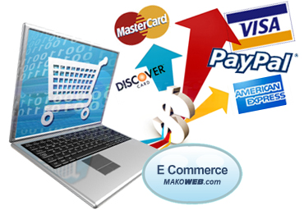
E-commerce
What is E-commerce?
= ______________________
Any type of business, or commercial transaction that involves the ________ of information across the internet.
Online shopping – buying and selling goods/services on Internet
_____________ Payments – mechanism to ____________
Notes:
Available since 1996, but browser support was not there. With advent of CSS 2.0, and IE 6 Netsape 6+ Opera 6+), it has been more practical to use style sheets.

Slide 3
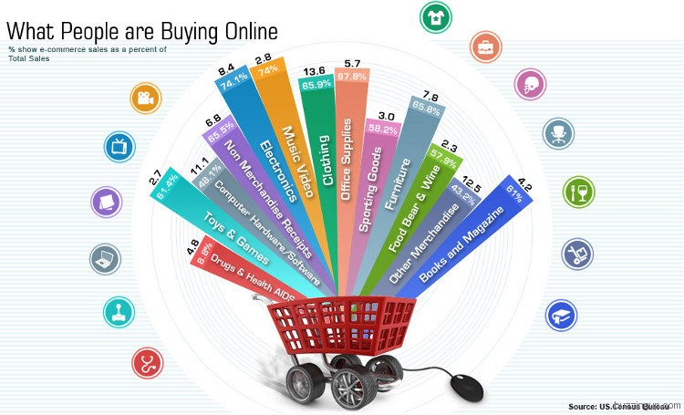
E-commerce
E-commerce businesses sell:
__________ Goods: ie books, gadgets, furniture, appliances (shipping involved)
_________ie. software, ebooks, musc, text, images, video etc. (immediate download)
__________: tickets, insurance etc. (ecopies)
It is estimated that the United States will spend an estimated 327 Billion Dollars online in 2016.
Notes:
Available since 1996, but browser support was not there. With advent of CSS 2.0, and IE 6 Netsape 6+ Opera 6+), it has been more practical to use style sheets.

Slide 4
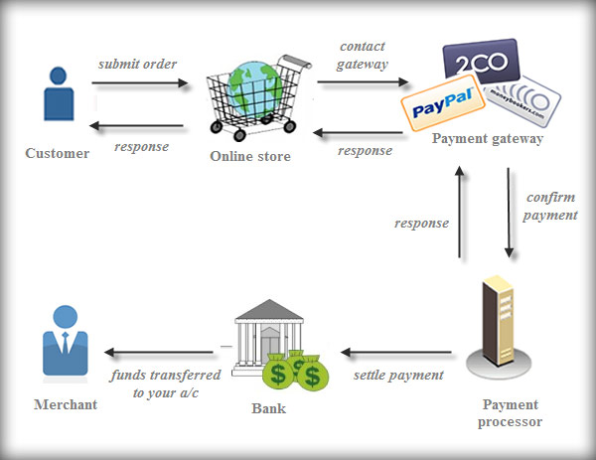

Slide 5
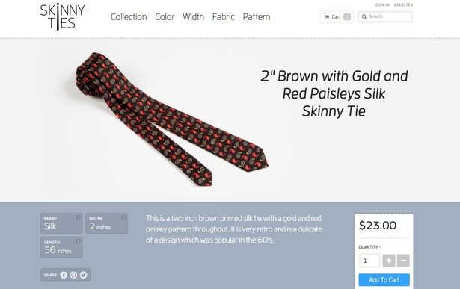
Examples of E-commerce
Purchasing Products
Online Auctions – internet auctions reaches more buyers/sellers
Internet Banking – banking operations without physical visit needed
Online Ticketing – Air tickets, movie tickets, train tickets, sporting events
http://skinnyties.com/
Notes:
Available since 1996, but browser support was not there. With advent of CSS 2.0, and IE 6 Netsape 6+ Opera 6+), it has been more practical to use style sheets.

Slide 6
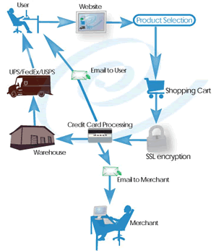
Advantages of E-commerce
“Holy grail of retail”
FOR Business
No geographic limitations - mobile
Gain new customers with search engine visibility
_____________________
Discount prices to consumer
Advertising and Marketing
Personnel – automated checkout, billing payments, inventory management
Lower # of employees
No realestate overhead
Offer _________________
Offer larger catalogs
Deal better with change of _________________
Notes:
Available since 1996, but browser support was not there. With advent of CSS 2.0, and IE 6 Netsape 6+ Opera 6+), it has been more practical to use style sheets.

Slide 7
Advantages of E-commerce
“Holy grail of retail”
For Customer
Eliminate Travel Time and Cost
Easy
Comparison Shopping
_________________
__________________
__________________
Notes:
Available since 1996, but browser support was not there. With advent of CSS 2.0, and IE 6 Netsape 6+ Opera 6+), it has been more practical to use style sheets.

Slide 8
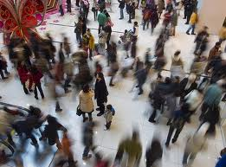

E-commerce
Disadvantages of E-commerce
Lacks Personal touch
E-commerce Delays Some Goods
Product Experience
Security:
Harvest of other information: Companies ask information about behaviour and preferences
Notes:
Available since 1996, but browser support was not there. With advent of CSS 2.0, and IE 6 Netsape 6+ Opera 6+), it has been more practical to use style sheets.

Slide 9
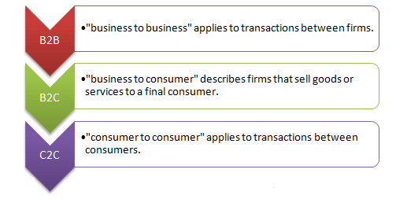
E-commerce
Types of E-commerce:
Business to Business (B2B)
Both transacting parties are businesses ie. manufacturers, traders, retailers etc.
Business to Consumer (B2C)
Businesses sell electronically to end-consumers
Consumer to Consumer (C2C)
A bartering system – auction sites
Notes:
Available since 1996, but browser support was not there. With advent of CSS 2.0, and IE 6 Netsape 6+ Opera 6+), it has been more practical to use style sheets.

Slide 10
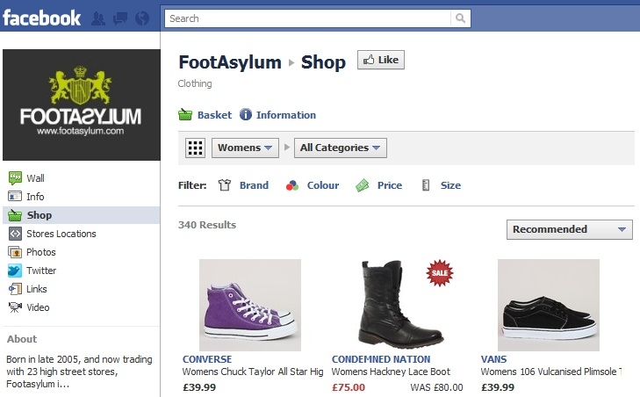
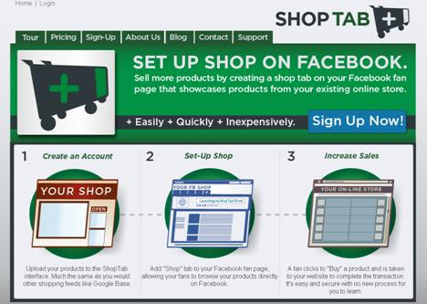
E-commerce
Specialized forms of E-commerce:
______________
Facebook commerce
Buying and selling through Facebook
Belief: captive audience
Actually: not sold on idea
___________________
Mobile commerce
Delivery of electronic commerce capabilities directly into consumer’s hand, anywhere, via wireless technology
Walmart estimated that 40% of all visits to their internet shopping site in Dec. 2013 was from mobile device.
→ popularity leading to new transactions
Notes:
Available since 1996, but browser support was not there. With advent of CSS 2.0, and IE 6 Netsape 6+ Opera 6+), it has been more practical to use style sheets.

Slide 11
E-commerce
Building Blocks of a Good E-commerce Website
Product Description – compelling → sale
Images – visual appeal, different views, models
Upfront Pricing – upfront ie. shipping, taxes,giftwrapping
Payment Options – acceptance methods
Shopping Cart – mandatory- accessiblity/ease
Easy to find products: internal search capabilities
Contact Info: - easy to find you
Customer Service:
Returns Policy clause
Rapid Checkout
Shipping Options
Security
Notes:
Available since 1996, but browser support was not there. With advent of CSS 2.0, and IE 6 Netsape 6+ Opera 6+), it has been more practical to use style sheets.

Slide 12
E-commerce
How to Get started with an online store?
Intent that you are selling a product/service
Need e-commerce enabled website
A merchant account:
Accepting online payments - collect
accepting credit cards through an _____________________ie paypal)
Shopping cart software allows consumers to:
Purchase goods or services, enter and keep up orders
Track customers
Notes:
Available since 1996, but browser support was not there. With advent of CSS 2.0, and IE 6 Netsape 6+ Opera 6+), it has been more practical to use style sheets.

Slide 13
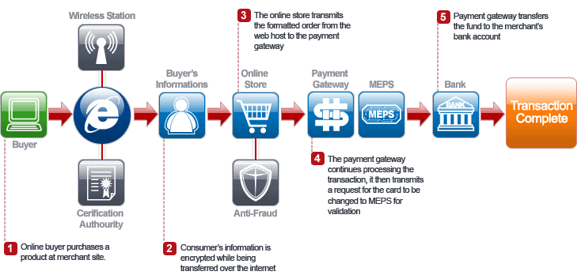
What is a Payment Gateway?
Service that ______________ and automates electronic payments made by shoppers to E-commerce merchants.
Acceptance of credit cards on websites
MEP – Malaysian Electronic Payment System
________________ service provider
Usually the payment gateway is bundled with your _____________ account.

Slide 14
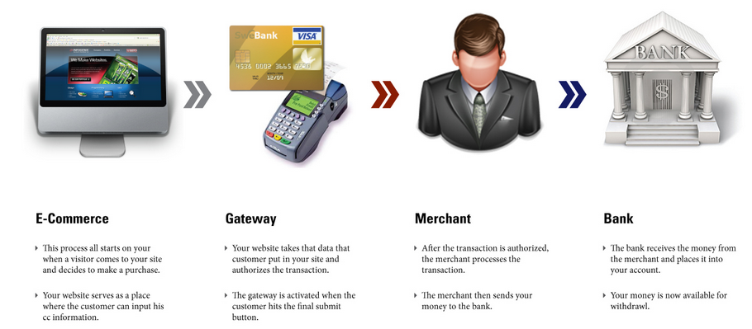
E-commerce Payment Gateway Process
Payment Gateway specific duties?
Software application that checks for:
Processing a transaction securely
Identification verification
Accept/reject transaction
Detect fraud
http://infogenix.com/blog/wp-content/uploads/2011/06/how_payment_gateways_work_large.jpg
Notes:
Available since 1996, but browser support was not there. With advent of CSS 2.0, and IE 6 Netsape 6+ Opera 6+), it has been more practical to use style sheets.

Slide 15
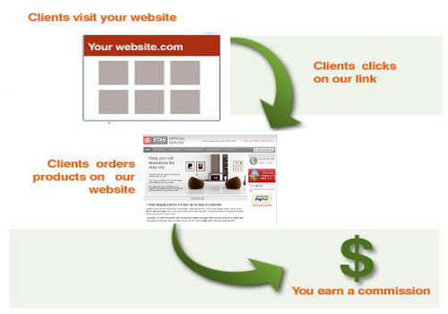
E-commerce
Affiliate Programs play a role in
E-commerce
Amazon pioneered affiliate programs
Also called Associate Programs
Arrangements in which an online merchant website pays affiliate websites a commission for traffic to them
__________________________
Banner is placed on affiliate website
Advertiser takes risk, if no one clicks on banner, then advertiser wastes money
__________________________
Also called Affiliate Links or click-thru-links
Put a link on your site, company pays you when someone click on the link. (5 to 20 cents per click)
Notes:
Available since 1996, but browser support was not there. With advent of CSS 2.0, and IE 6 Netsape 6+ Opera 6+), it has been more practical to use style sheets.

Slide 16
E-commerce
Implementing E-Commerce Site
Choices are:
Enterprise Computing
Virtual hosting services
Simplified e-commerce
Flexibility Decreases
Simplicity Increases
Enterprise Computing (Amazon, Dell)
Purchase hardware, software
Hire your developers
To create your own e-commerce site
Applicable if:
High traffic – million visitors per month
Large catalog database
Complicated sales cycle ie. forms, pricing tables
Other businesses need to be integrated together
Virtual Hosting Services
Dependent on vendor host provider
They maintain the equipment and software and sell in standardized packages
Includes merchant account, security
Simplified E-commerce:
Small business use this
Vendor provides a simplified system for creating your store.
Online forms provided
Yahoo Stores, Verio Stores ($$/month)
Notes:
Available since 1996, but browser support was not there. With advent of CSS 2.0, and IE 6 Netsape 6+ Opera 6+), it has been more practical to use style sheets.

Slide 17
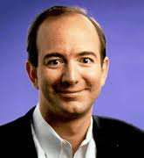



E-commerce
History of E-commerce
1980s:
Directly from online CompuServe added a service called Electronic Mall
Purchase from merchants – not successful
1990: Tim Berners Lee (WWW)
1994- 1995:
Began working with processing online credit card sales
1995 (July):
Jeff Bezos boxed up the first book ever sold on Amazon from Seattle garage
Within 30 days of business – sold to online shoppers in 50 states and countries Cheap to ship, and easy to order from publishers.
Amazon.com – set standard for customer-oriented E-commerce Website.
1995: Ebay – Pierre Omidyar – broken laser pointer
Amazon.com and Ebay.com paved the way to today’s E-commerce merchant.
Notes:
Available since 1996, but browser support was not there. With advent of CSS 2.0, and IE 6 Netsape 6+ Opera 6+), it has been more practical to use style sheets.

Slide 18
And now the Review

